Slide 1
Genomic data

Slide 2
Definitions
Genome assembly:
A computational representation of a genome. Different versions are available.
Human:
hg19 - GRCh37
hg38 - GRCh38
T2T
Mouse
mm10
Mm39 - GRCm39
Chromosome names: chr1

Slide 3
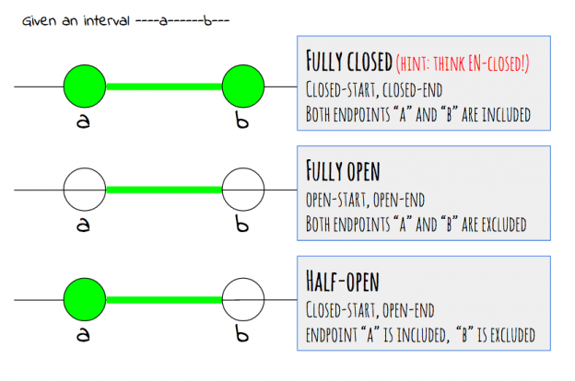
Coordinates
Chromosome name: „chr1“ or „1“ (UCSC vs NCBI)
Start position
End position
Chromosome strand
‘+’ for the forward strand
‘-’ for the reverse stranded
‘*’ for both strands / unstranded features
Start <= end
Counting from 0 or 1
Half-open vs fully-closed coordinates

Slide 4
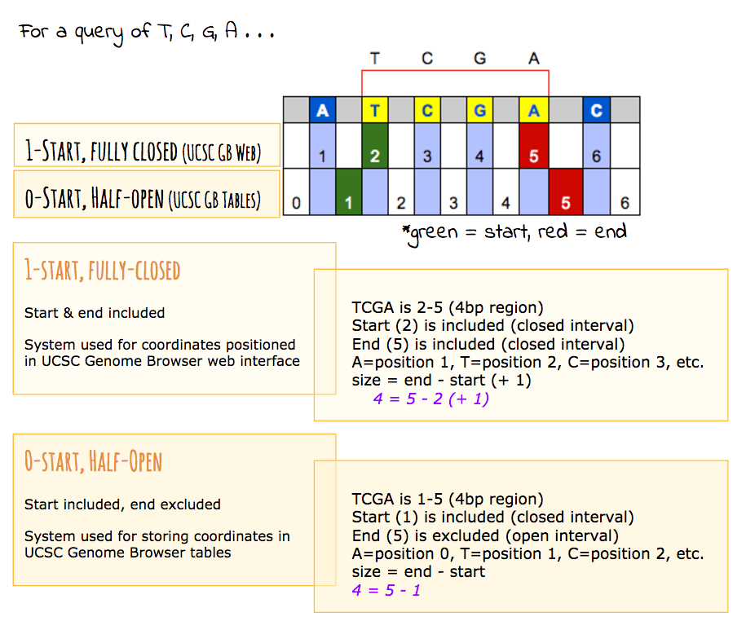
Coordinates
Format | Index | End coordinates
BED | 0 | Half-open
BigBed | 0 | Half-open
GTF2 | 1 | Fully-closed
GFF3 | 1 | Fully closed
Other GFFs | Either | Either
PSL | 0 | Half-open
SAM | 1 | n/a
BAM | 0 | n/a
bowtie | 0 | n/a
bedGraph | 0 | Half-open
BigWig* | 0 or 1 | Half-open or n/a
Wiggle | 1 | n/a

Slide 5
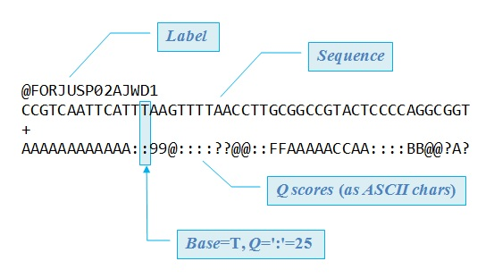
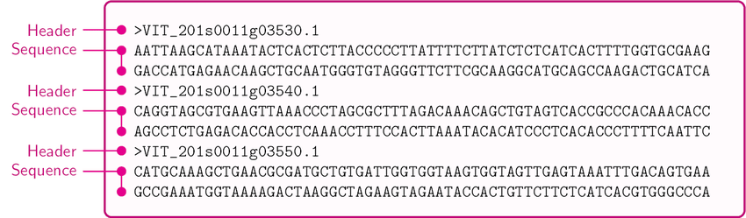
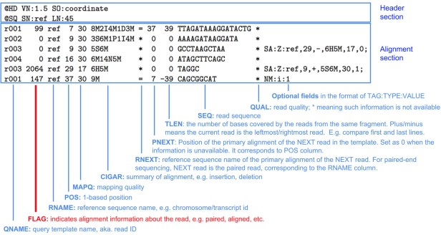
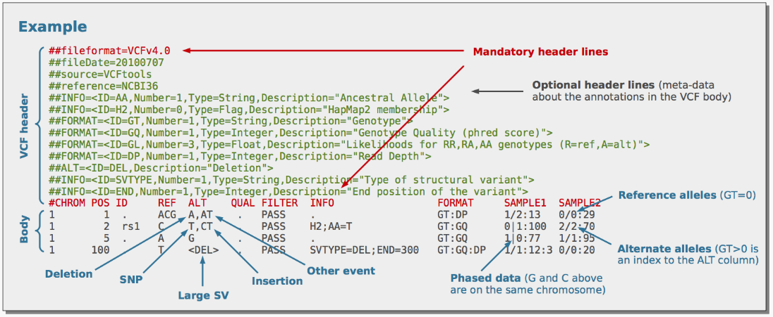
Some important file types
Sequence formats:
FASTA, FASTQ
Alignment formats:
BAM, SAM, CRAM
Variants:
vcf
Maf: mandatory fields: Hugo_Symbol, Chromosome, Start_Position, End_Position, Reference_Allele, Tumor_Seq_Allele2, Variant_Classification, Variant_Type and Tumor_Sample_Barcode.

Slide 6
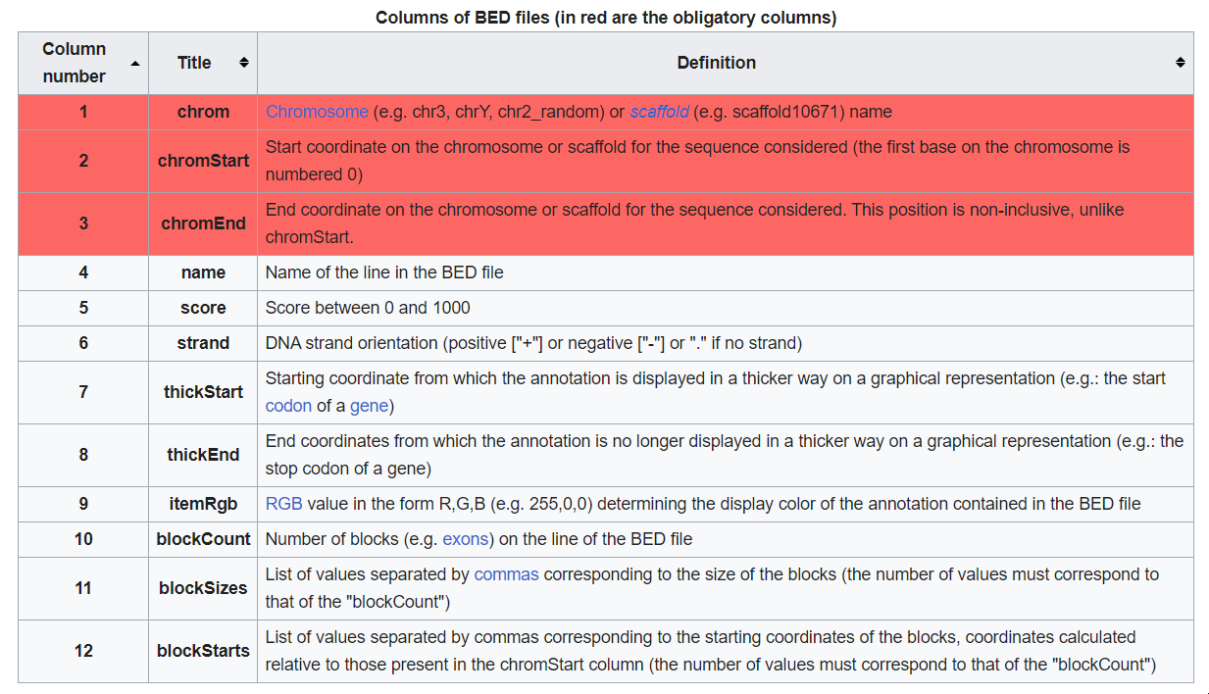
Some important file types
GTF, GFF
BED, bedGraph

Slide 7
Module
S4 Classes, Granges, SummarizedExperiment, UCSC browser
Differential gene expression analysis
Annotation packages, conversion of Ids
Analysis of RNASeq data, models, normalization, visualization, batch effect correction
Enrichment analysis, pathway analysis
Mutation analysis, CNVs, visualization
Working with mutation data
Visualizing genomic data, heatmaps, other types of plots
Single cell analysis?, Analysis of interval data (methylation, ATAC-seq, ChiP-seq)?
Reproducible programming

